Slide 1
CS 252 Database Management Systems
Jan – May 2020
IV Semester
* Use the slides for reference only. Refer the text book for details.

Slide 2
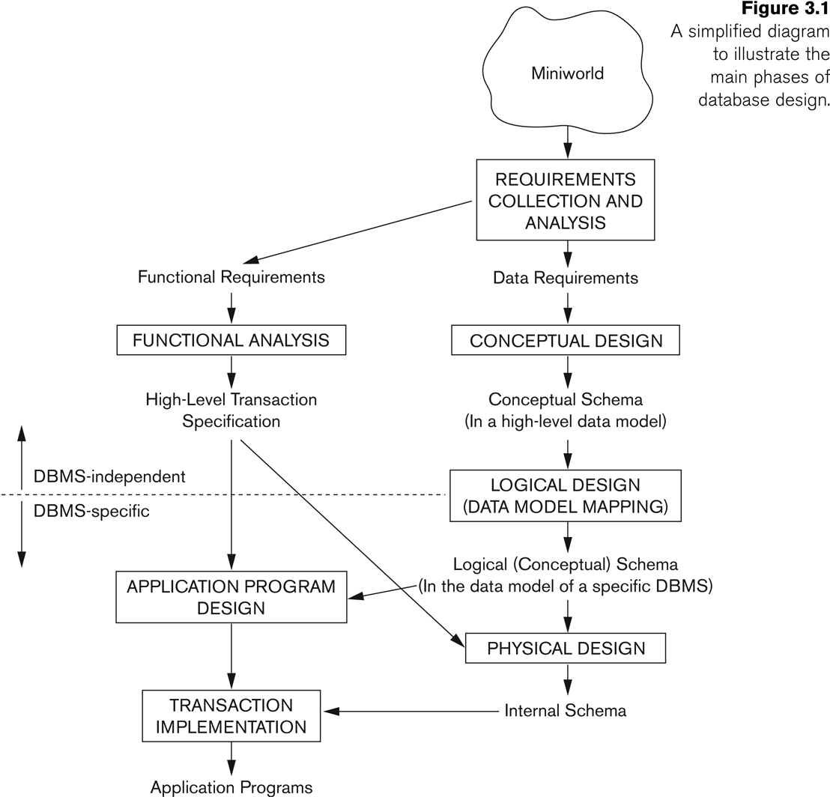
Overview of Database Design Process

Slide 3
Relational Database Design by ER- to-Relational Mapping
GOALS during Mapping
Preserve all information (that includes all attributes)
Maintain the constraints to the extent possible (Relational Model cannot preserve all contstraints- e.g., max cardinality ratio such as 1:10 in ER; exhaustive classification into subtypes, e.g., STUDENTS are specialized into Domestic and Foreign)
Minimize null values

Slide 4
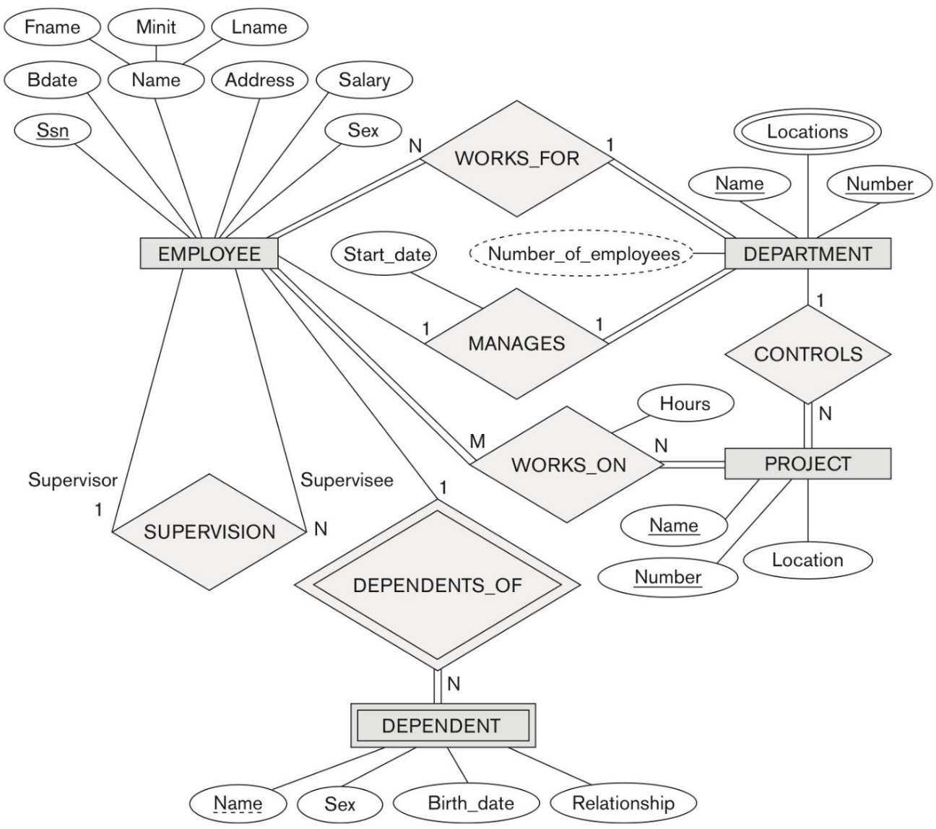
ER diagram for the COMPANY database

Slide 5
ER-to-Relational Mapping Algorithm
Step 1: Mapping of Regular Entity Types
For each regular (strong) entity type E in the ER schema, create a relation R that includes all the simple attributes of E.
Choose one of the key attributes of E as the primary key for R.
If the chosen key of E is composite, the set of simple attributes that form it will together form the primary key of R.
Example: We create the relations EMPLOYEE, DEPARTMENT, and PROJECT in the relational schema corresponding to the regular entities in the ER diagram.
SSN, DNUMBER, and PNUMBER are the primary keys for the relations EMPLOYEE, DEPARTMENT, and PROJECT as shown.

Slide 6
ER-to-Relational Mapping Algorithm
Step 2: Mapping of Weak Entity Types
For each weak entity type W in the ER schema with owner entity type E, create a relation R and include all simple attributes (or simple components of composite attributes) of W as attributes of R.
Also, include as foreign key attributes of R the primary key attribute(s) of the relation(s) that correspond to the owner entity type(s).
The primary key of R is the combination of the primary key(s) of the owner(s) and the partial key of the weak entity type W, if any.
Example: Create the relation DEPENDENT in this step to correspond to the weak entity type DEPENDENT.
Include the primary key SSN of the EMPLOYEE relation as a foreign key attribute of DEPENDENT (renamed to ESSN).
The primary key of the DEPENDENT relation is the combination {ESSN, DEPENDENT_NAME} because DEPENDENT_NAME is the partial key of DEPENDENT.

Slide 7
ER-to-Relational Mapping Algorithm
Step 3: Mapping of Binary 1:1 Relation Types
For each binary 1:1 relationship type R in the ER schema, identify the relations S and T that correspond to the entity types participating in R.
There are three possible approaches:
Foreign Key ( 2 relations) approach: Choose one of the relations-say S-and include a foreign key in S the primary key of T. It is better to choose an entity type with total participation in R in the role of S.
Example: 1:1 relation MANAGES is mapped by choosing the participating entity type DEPARTMENT to serve in the role of S, because its participation in the MANAGES relationship type is total.
Merged relation (1 relation) option: An alternate mapping of a 1:1 relationship type is possible by merging the two entity types and the relationship into a single relation. This may be appropriate when both participations are total.
Cross-reference or relationship relation ( 3 relations) option: The third alternative is to set up a third relation R for the purpose of cross-referencing the primary keys of the two relations S and T representing the entity types.

Slide 8
ER-to-Relational Mapping Algorithm
Step 4: Mapping of Binary 1:N Relationship Types.
For each regular binary 1:N relationship type R, identify the relation S that represent the participating entity type at the N-side of the relationship type.
Include as foreign key in S the primary key of the relation T that represents the other entity type participating in R.
Include any simple attributes of the 1:N relation type as attributes of S.
Example: 1:N relationship types WORKS_FOR, CONTROLS, and SUPERVISION in the figure.
For WORKS_FOR we include the primary key DNUMBER of the DEPARTMENT relation as foreign key in the EMPLOYEE relation and call it DNO.
An alternative approach is to use a Relationship relation (cross referencing relation) – this is rarely done.

Slide 9
ER-to-Relational Mapping Algorithm
Step 5: Mapping of Binary M:N Relationship Types.
For each regular binary M:N relationship type R, create a new relation S to represent R. This is a relationship relation.
Include as foreign key attributes in S the primary keys of the relations that represent the participating entity types; their combination will form the primary key of S.
Also include any simple attributes of the M:N relationship type (or simple components of composite attributes) as attributes of S.
Example: The M:N relationship type WORKS_ON from the ER diagram is mapped by creating a relation WORKS_ON in the relational database schema.
The primary keys of the PROJECT and EMPLOYEE relations are included as foreign keys in WORKS_ON and renamed PNO and ESSN, respectively.
Attribute HOURS in WORKS_ON represents the HOURS attribute of the relation type. The primary key of the WORKS_ON relation is the combination of the foreign key attributes {ESSN, PNO}.

Slide 10
ER-to-Relational Mapping Algorithm
Step 6: Mapping of Multivalued attributes.
For each multivalued attribute A, create a new relation R.
This relation R will include an attribute corresponding to A, plus the primary key attribute K-as a foreign key in R-of the relation that represents the entity type of relationship type that has A as an attribute.
The primary key of R is the combination of A and K. If the multivalued attribute is composite, we include its simple components.
Example: The relation DEPT_LOCATIONS is created.
The attribute DLOCATION represents the multivalued attribute LOCATIONS of DEPARTMENT, while DNUMBER-as foreign key-represents the primary key of the DEPARTMENT relation.
The primary key of R is the combination of {DNUMBER, DLOCATION}.

Slide 11
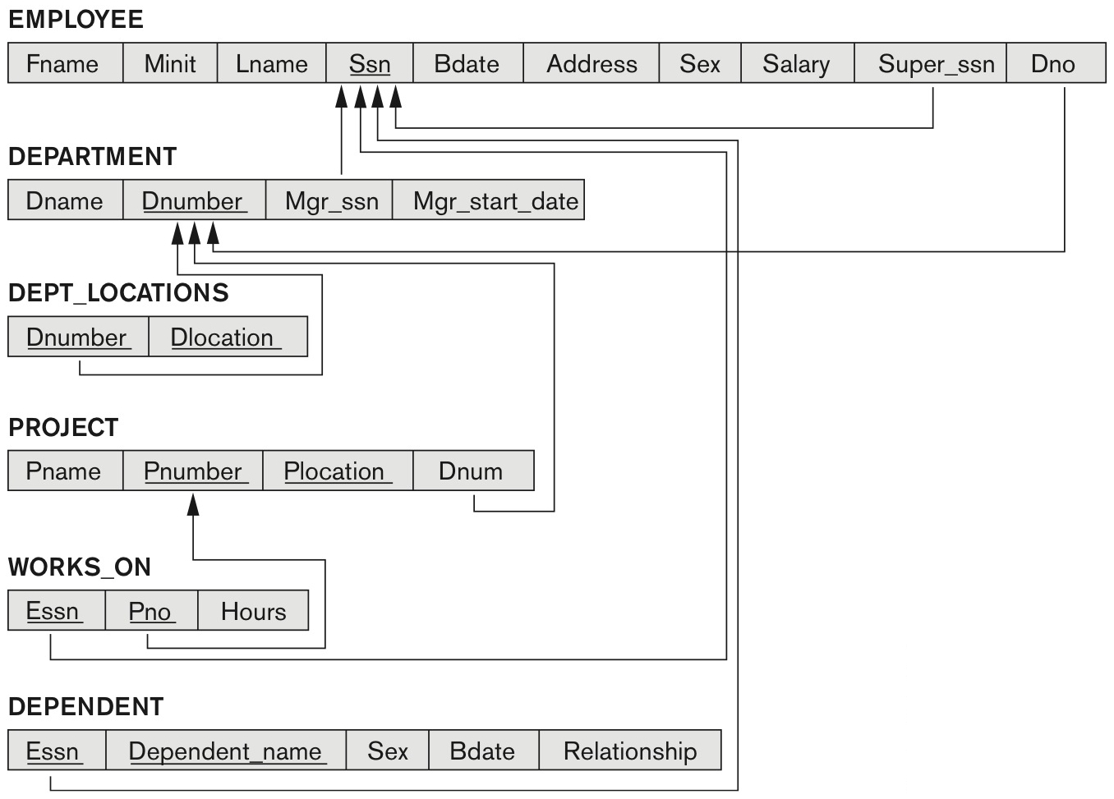
Result of mapping the COMPANY ER schema into a relational database schema

Slide 12
ER-to-Relational Mapping Algorithm
Step 7: Mapping of N-ary Relationship Types.
For each n-ary relationship type R, where n>2, create a new relationship S to represent R.
Include as foreign key attributes in S the primary keys of the relations that represent the participating entity types.
Also include any simple attributes of the n-ary relationship type (or simple components of composite attributes) as attributes of S.
Example: The relationship type SUPPLY in the ER on the next slide.
This can be mapped to the relation SUPPLY shown in the relational schema, whose primary key is the combination of the three foreign keys {SNAME, PARTNO, PROJNAME}

Slide 13
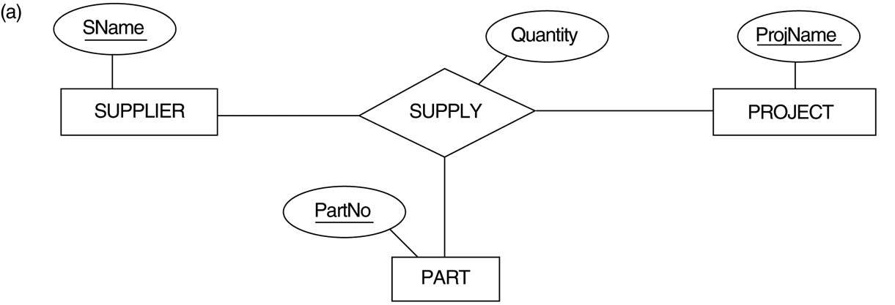
TERNARY RELATIONSHIP: SUPPLY

Slide 14
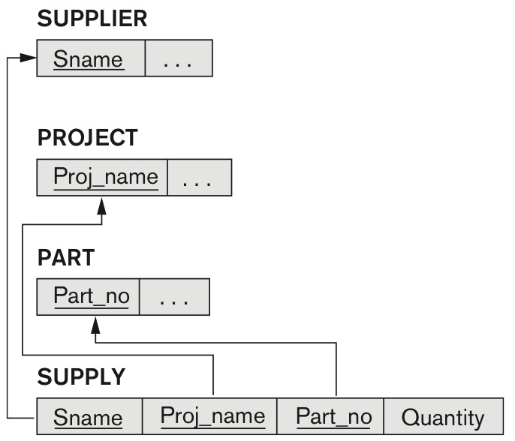
Mapping the n-ary relationship type SUPPLY

Slide 15
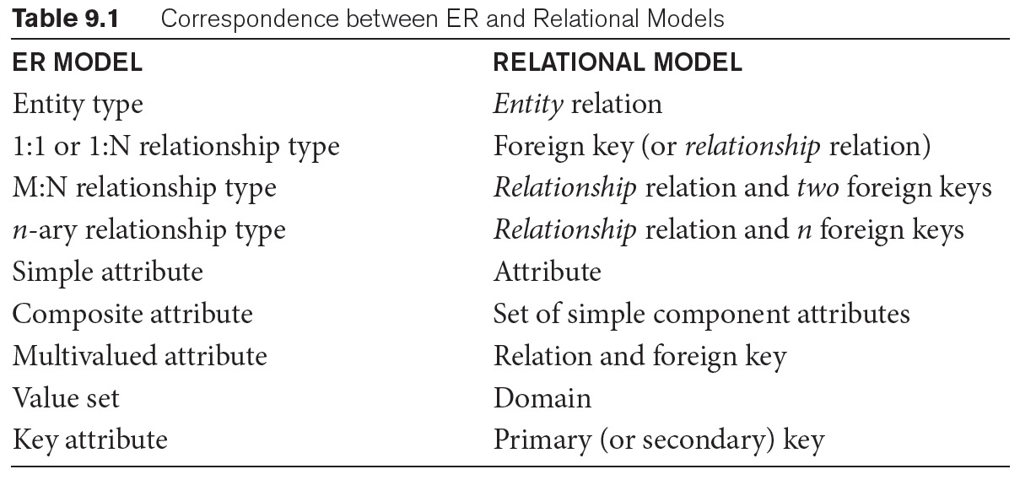
Summary of Mapping constructs and constraints

